Slide 1


Fundamentals of Risk Management
RM System, Process, & Program
Incident Investigation & Analysis
RM Tools & Challenges
People & Organizations
RM as Applied in Industry
Leadership in RM
Applications & Perspectives
On Becoming a
Leader in Risk Management
ENGG404 - Lecture
Case Study 5:
Mount Polley Tailings Storage Facility Failure, Imperial Metals,
near Likely, British Columbia,
4-August-2014

Slide 2
Learning Outcomes:
Explore the basis for complacency in the following risk management system elements, and explain:
Management Leadership, Commitment and Accountability
Risk Assessment and Management of Risks
Design, Construction and Start-up
Employee Competency and Training
Recognize a situation where the degradation of management leadership and risk assessment applies to a loss incident, and apply the principles of risk management in a case study analysis.
Update: https://www.cbc.ca/news/canada/british-columbia/discipline-engineers-mount-polley-mine-waste-quesnel-lake-1.6137265
Case 5 Mount Polley LI
2
Notes:
2

Slide 3
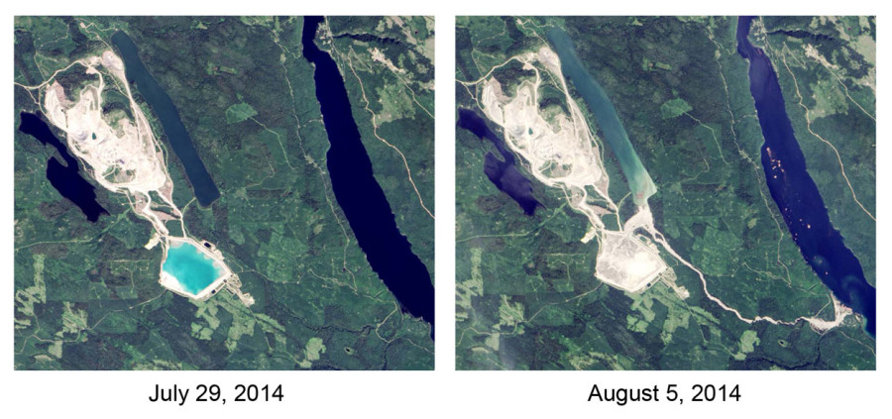
Mount Polley – Before and After the Technical Loss Incident:
BEFORE
The Tailings Storage Facility (TSF) is intact – the blue pond.
AFTER
The TSF has failed.
Contamination
Contamination
Case 5 Mount Polley LI
3
Notes:
3

Slide 4
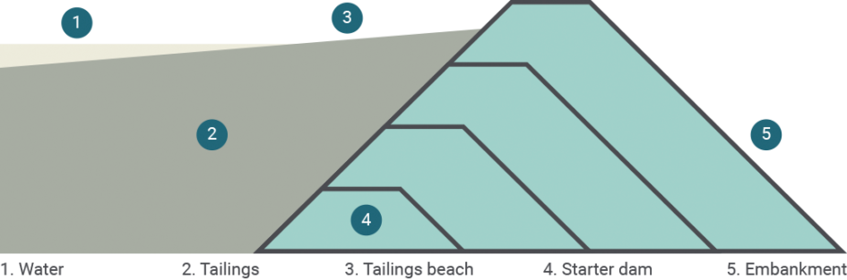
Immediate (and Intermediate) Causes:
The weak clay layer below embankment failed from excessive stress due to:
  Overly steep slope downstream of the embankment
  Embankment height higher than design standards (~40m)
  Open sub-excavation at the toe of the embankment
  Surplus of water in TSF (Tailings Storage Facility)
  Insufficient tailings beaches to protect embankment structure
Case 5 Mount Polley LI
4
Notes:
4

Slide 5
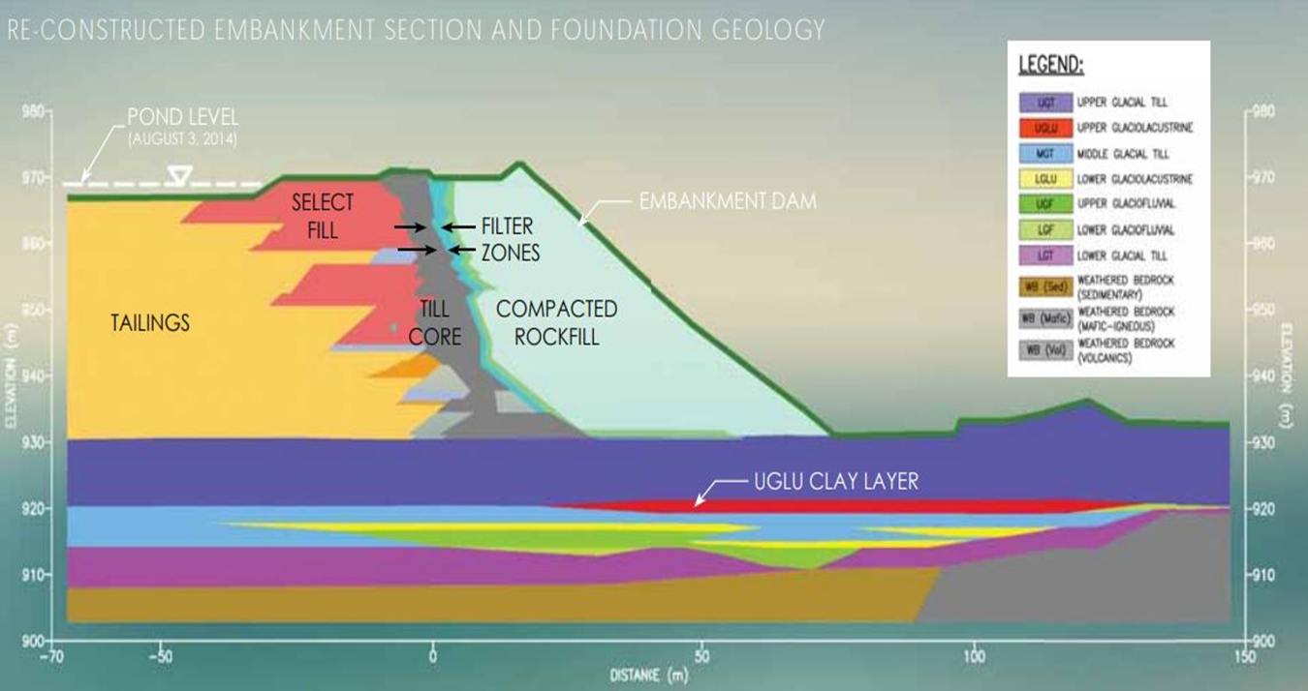
Technical Causes of the Incident:
The embankment dam structure failed.
Case 5 Mount Polley LI
5
Notes:
5

Slide 6
Basic Causes:
Engineering and Design Factors:
Inadequate evaluation of change: Risks introduced by the sub excavation activity at the toe of the embankment were not identified nor assessed.
Inadequate monitoring of construction: Subexcavation remained open for 8 months without any concern from engineers or management.
Job Factors:
Inadequate guidance manuals: The construction manual for buttress excavation did not include any construction procedures.
Inadequate inspection/monitoring: Inadequate supervision during TSF operations
Inadequate work planning: Inadequate water management plan
Personal Factors:
Improper risk taking: Design engineers were overconfident in their professional judgement
Case 5 Mount Polley LI
6
Notes:
6

Slide 7
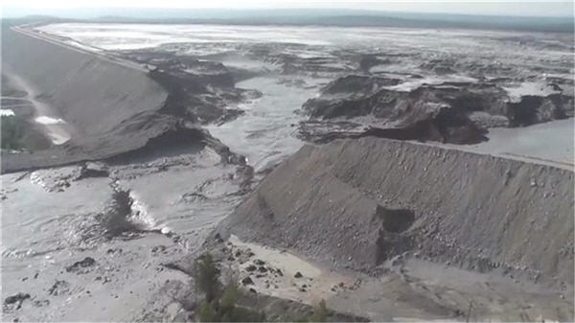
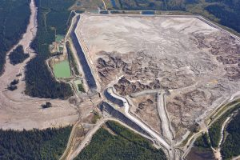
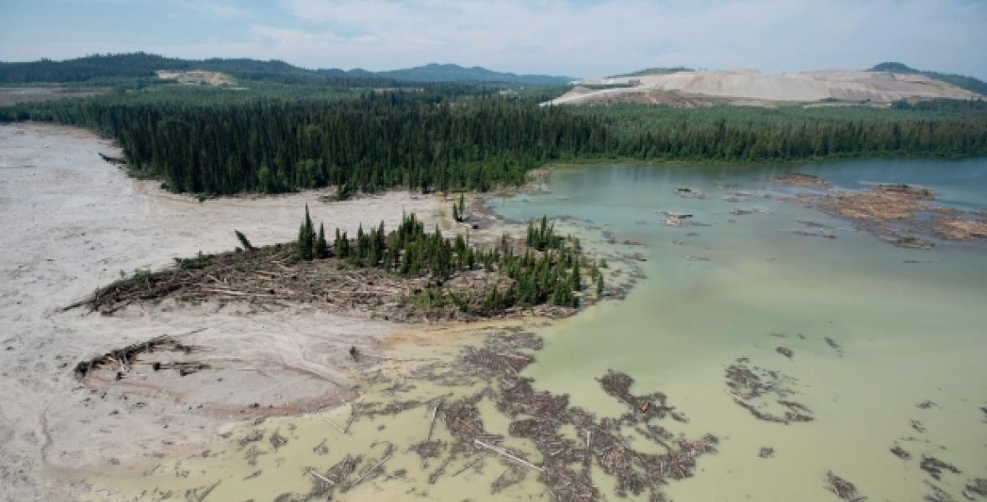
Mount Polley – Latent Causes and Lessons in Leadership:
It is vital to combat complacency in all aspects
of risk management.
Using this list, select one and think about possible
causes of failure in organizational leadership:
Management Leadership, Commitment and Accountability
Risk Assessment and Management of Risks
Community Awareness and Emergency Preparedness
Management of Change.
Incident Reporting, Investigation, Analysis and Actions
Program Evaluation and Continuous Improvement.
Design, Construction and Start-up
Operations and Maintenance.
Employee Competency and Training.
Contractor Competency and Integration.
Operations and Facilities Information and Documentation.
Case 5 Mount Polley LI
7

Slide 8
An Examination of the Weaknesses in RM Elements (LC’s):
#1 MLCA:
Lack of management commitment, leadership, and accountability
Management ignored previous warnings and concerns from Regulator and employees
#2 RA&MR:
Inadequate risk assessment and management of risk
Insufficient hazard identification during operations in TSF
Management provided inadequate supervision and inspections during operations
#7 DC&SU:
Inadequate design and assessment
Design team had a poor understanding of underlying terrain during the design phase of TSF
Design team heavily relied on Factor of Safety calculations prone to error
#9 EC&T:
Inadequate employee competency
Unqualified personnel overseeing water management program
Case 5 Mount Polley LI
8
Notes:
8

Slide 9
ALE #1: Can you draft a latent cause statement?
Please confer (Open discussion), select one of these management system elements and draft a statement for a latent cause:
#2 RA&MR:
Inadequate risk assessment and management of risk
Insufficient hazard identification during operations in TSF
Management provided inadequate supervision and inspections during operations
#7 DC&SU:
Inadequate design and assessment
Design team had a poor understanding of underlying terrain during the design phase of TSF
Design team heavily relied on Factor of Safety calculations prone to error
#9 EC&T:
Inadequate employee competency
Unqualified personnel overseeing water management program
Case 5 Mount Polley LI
9
Notes:
9

Slide 10
Mount Polley LI: Latent Cause Relating to RME#2
RME #2: Risk Assessment and Management of Risks:
  Initial and on-going, continuing need to assess and manage risks.
    Substandard hazard identification program resulted in unaddressed risks during the operations phase of the TSF:
    TSF Inspections were not adequately performed nor adequately supervised
    Latent Cause:
    LC-S: The risk assessment program did not include a standard to identify and assess hazards of the TSF foundation and hydraulic conditions while the TSF was in operation. #2 RAMR
Case 5 Mount Polley LI
10
Notes:
10

Slide 11
Mount Polley LI: Latent Cause Relating to RME#7
RME #7: Design, Construction and Start-up:
  Risk assessment during design is vital to assess and control the risks.
  Design team heavily relied on Factor of Safety (FoS) calculations, but they were not reliable.
    Used unsuitable calculation guidelines from the Canadian Dam Association
    Calculations used data from an inadequate assessment, leading to incorrect calculations
  The Mining Association of Canada’s guidelines were not followed.
    Design team relied more on their professional judgement
    Guidelines would have likely identified most of the key technical causes.
    Latent Cause:
    LC-S: The design program standard for applying the factors of safety during the design phase of the TSF project did not reference the necessary calculation guidelines from the Mining Association of Canada. #7 DCSU
Case 5 Mount Polley LI
11
Notes:
11

Slide 12
Mount Polley LI: Latent Cause Relating to RME#9
RME #9: Employee Competency and Training:
  Must ensure that employees are fully competent.
    The individual who was hired to lead the water management plan was not qualified. Through the actions of this individual, this resulted in excess water levels in the TSF.
    Latent Cause:
    LC-S: The employee competency program standard for recruiting, selecting, and hiring new employees was inadequate. #9 ECT
Case 5 Mount Polley LI
12
Notes:
12

Slide 13
Mount Polley LI: Latent Cause Relating to RME#1
RME #1: Management Leadership, Commitment, and Accountability
  Corporate Safety Culture: Leadership influences and drives culture; values and actions define the culture. Both a good culture and sound risk management program are necessary for sustainable performance.
  The concerns of employees and regulators about the TSF were ignored by Imperial Metals management.
  Latent Cause:
  LC-S: The leadership program did not include a management standard to assign responsibility and drive accountability for oversight of the safe TSF operation in addressing safety concerns. #1 MLCA
Case 5 Mount Polley LI
13
Notes:
13

Slide 14
Mount Polley LI: Recommendations Based on Latent Causes?
What recommendations could you make for each latent cause?
  LC-S: The leadership program did not include a management plan (standard) to assign responsibility and drive accountability for oversight of the safe TSF operation in addressing safety concerns. #1 MLCA
  LC-S: The risk assessment program did not include a standard to identify and assess hazards of the TSF foundation and hydraulic conditions while the TSF was in operation. #2 RAMR
  LC-S: The design program standard for applying the factors of safety during the design phase of the TSF project did not reference the necessary calculation guidelines from the Mining Association of Canada. #7 DCSU
  LC-S: The employee competency program standard for recruiting, selecting, and hiring new employees was inadequate. #9 ECT
  We will come back to this – how to make recommendations – later in the term.
Case 5 Mount Polley LI
14
Notes:
14

Slide 15
Mount Polley LI: Impact on the Mining Industry
Incident investigations can result in changes beyond the organization involved in the loss incident!
As a result of the Mount Polley incident, several changes were made to guidelines and practices for tailings facilities.
Changes to the Mining Association of Canada’s “A Guide to the Management of Tailings Facilities” (2019) and the B.C. Government’s “Health, Safety and Reclamation Code for Mines in British Columbia” (2017) include:
  Requiring an independent review of site selection, design, construction, operation, investigation, and closure for tailings facilities.
  Improved risk assessment methodology, including a risk-based ranking system for non-conformances.
  Additional regulations for managing the change of Engineers of Record and ownership
  More technical guidance for site selection and design
  But for the purposes of your Team project, limit latent causes (and recommendations to what is within the scope of The ABC Conglomerate).
Case 5 Mount Polley LI
15
Notes:
15

Slide 16

Look into the future about your career …
Q: Will you ever be in this situation?
“Seven years after Canada's largest tailings spill, the two engineers who
were involved have been found in breach of their professional codes
of conduct, Engineers and Geoscientists of British Columbia (EGBC)
The panel found that both Rice and Fidel demonstrated unprofessional conduct in the course of their work at the mine. …
EGBC reported that a discipline hearing panel had imposed a maximum fine of $25,000 against Rice, who resigned in 2018. Rice also agreed to pay $107,500 dollars in legal costs to the association and is no longer permitted to practice as a professional engineer in the province.
A separate discipline hearing panel found that Fidel also committed several acts of unprofessional conduct.”
https://www.cbc.ca/news/canada/british-columbia/discipline-engineers-mount-polley-mine-waste-quesnel-lake-1.6137265
A: Not when practicing the principles and practices of “Leadership in Risk Management”, a key competency!
We will revisit ethics and professional conduct later in the term.
Case 5 Mount Polley LI
16
Notes:
16

Slide 17
Summary and Key Lessons:
It is vital to combat complacency in all aspects of risk management.
How quickly does management address identified deficiencies? Are responsibilities embraced or deflected to others?
#1 MLCA Management Leadership, Commitment, and Accountability
How are hazards identified and assessed throughout the facility lifecycle? Is this system embedded throughout the organization?
#2 RAMR Risk Assessment and Management of Risks
Are accepted standards of practice used for risk assessment during design and other stages? Can the certainty and confidence in obtained results be reasonably justified?
#7 DCSU Design, Construction and Start-up
Are employees fully trained and qualified for their roles? Does management have an effective training program in place?
#9 ECT Employee Competency and Training
Lastly, the key lesson is applying the RM principles, practices, and concepts to analyse a case study / loss incident!
Case 5 Mount Polley LI
17
Notes:
17

Slide 18
Any questions?
Notes:
18

